Slide 1
Introduction to Programming in c

Slide 2
ToPICs List
Variables
Syntax
Data Types
Constants
Strings
Print & Scan
Comments
Operators
Logic (Decision Making)
Loops
Arrays
Functions
Project Structure
Design Flow
Debugging

Slide 3
Compilation
Compiling is the transformation from Source Code (human readable) into machine code (computer executable). A compiler is a program. A compiler takes the recipe (code) for a new program (written in a high level language) and transforms this Code into a new language (Machine Language) that can be understood by the computer itself. This "machine language" is difficult to impossible for humans to read and understand (much less debug and maintain), thus the need for "high level languages" such as C.

Slide 4
Syntax
In a C program, the semicolon is a statement terminator. So each individual statement must be ended with a semicolon. It indicates the end of one logical entity. Given below are two different statements −
printf("Hello, World! \n");
return 0;
A C identifier is a name used to identify a variable, function, or any other user-defined item. An identifier starts with a letter A to Z, a to z, or an underscore '_' followed by zero or more letters, underscores, and digits (0 to 9).
C does not allow punctuation characters such as @, $, and % within identifiers. C is a case-sensitive programming language.

Slide 5
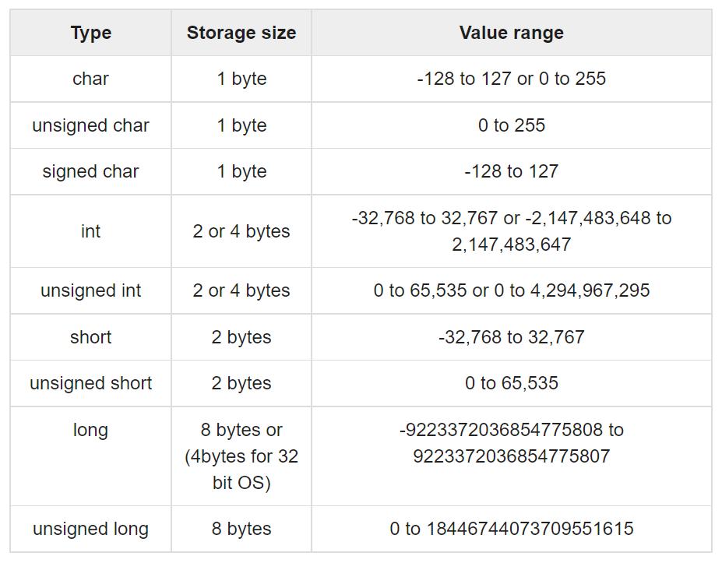
Data Types
Integer Types

Slide 6
Data Types
Floating-Point Type
Void type and keyword is used to specify that no value is available. This can be used for function outputs or arguments.

Slide 7
Strings
Strings are a special type which are actually just a one-dimensional array of characters terminated by a null character ‘\0’.
The first way to create a string is by defining an array of individual characters: char greeting[6] = {'H', 'e', 'l', 'l', 'o', '\0’};
The second way is by using “” and also defining a char array:
char greeting[] = “Hello”;
In the second method, the compiler will include the null character at the end of the array automatically.

Slide 8
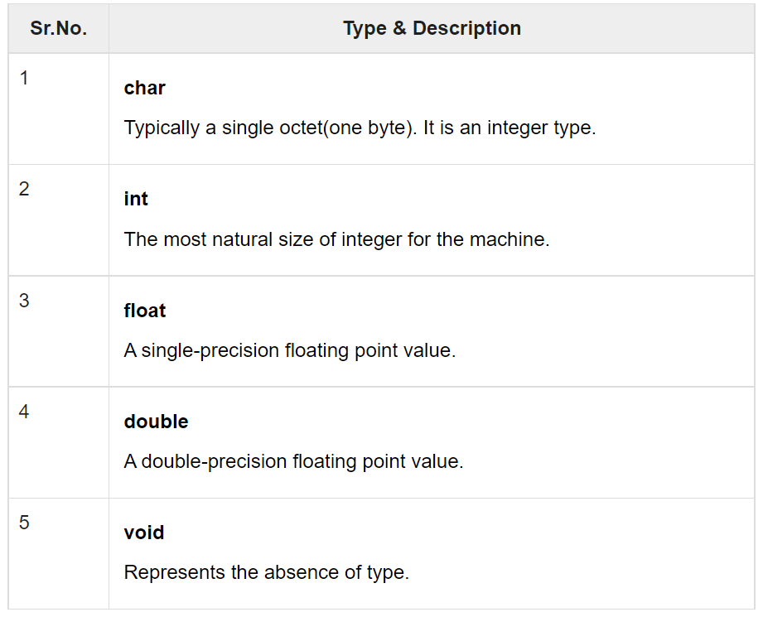
Variables
A variable is a storage area that our programs can modify. A variable always has a data-type

Slide 9
Variables
A variable is defined with the following syntax:
<type> <variable name>;
int x, y, z;
char a, b, example;
float var_f;
double decimal8;
A variable can then be initialized in a later line, or at the same time it is defined
int z = 99;
example = ‘F’;

Slide 10
Constants
Constants refer to fixed values that the program may not alter during its execution. These fixed values are also called literals.
Constants can be of any of the basic data types like an integer constant, a floating constant, a character constant, or a string literal.
You can create a constant using the “define” or “const” keyword
<#define> <identifier name> <identifier value> (no ; needed)
<const> <data type> <variable name> = <value>;
#define favorite 7
#define example 28
const char letter = ‘d’;

Slide 11
Print & Scan I/o
Scanf is the keyword used for user input
Printf is the keyword used for program output
The int scanf(const char *format, ...) function reads the input from the standard input stream stdin and scans that input according to the format provided.
The int printf(const char *format, ...) function writes the output to the standard output stream stdout and produces the output according to the format provided.

Slide 12
Print & Scan I/o Example
#include <stdio.h>
int main( ) {
char str[100];
int i;
printf( "Enter a value :");
scanf("%s %d", str, &i);
printf( "\nYou entered: %s %d ", str, i);
return 0;
}

Slide 13
Comments
Comments do not change the outputs or functionality of your code in anyway, they are ignored by the compiler. They are great for explaining the different parts of your code.
There are two ways to create comments in C, using // or /**/, both shown below:
//This is a one line comment
/*This is a
multiple line comment*/

Slide 14
Operators
An operator is a symbol that tells the compiler to perform specific mathematical or logical functions.
There following are the different types of operators in C:
Arithmetic Operators
Relational Operators
Logical Operators
Bitwise Operators
Assignment Operators
Misc Operators
https://www.tutorialspoint.com/cprogramming/c_operators.htm

Slide 15
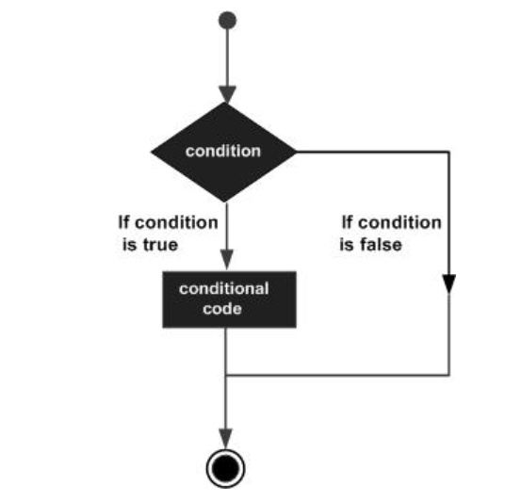
Logic (Decision Making)
Decisions in C are performed by evaluating a condition and executing a statement depending on whether the condition was met or not met.

Slide 16
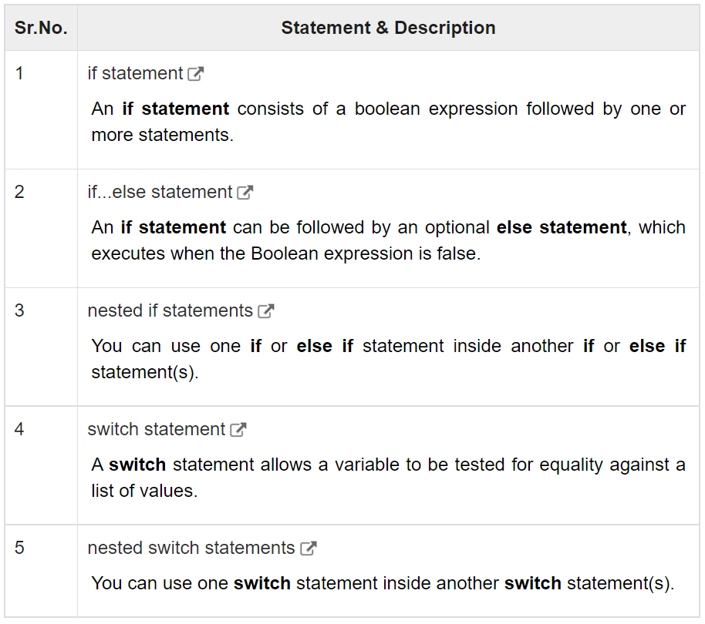
Logic (Decision Making)

Slide 17
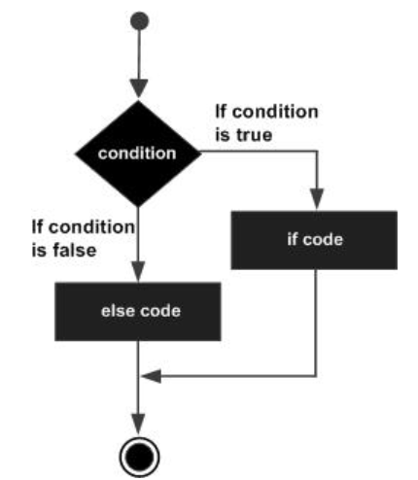
Logic (Decision Making)
The if else statement is used to evaluate a condition, and if it is not met, perform some other defined action. You can also nest if elses.
The syntax is:
if(boolean_expression) {
/* statement(s) will execute if the boolean expression is true */
} else {
/* statement(s) will execute if the boolean expression is false */
}

Slide 18
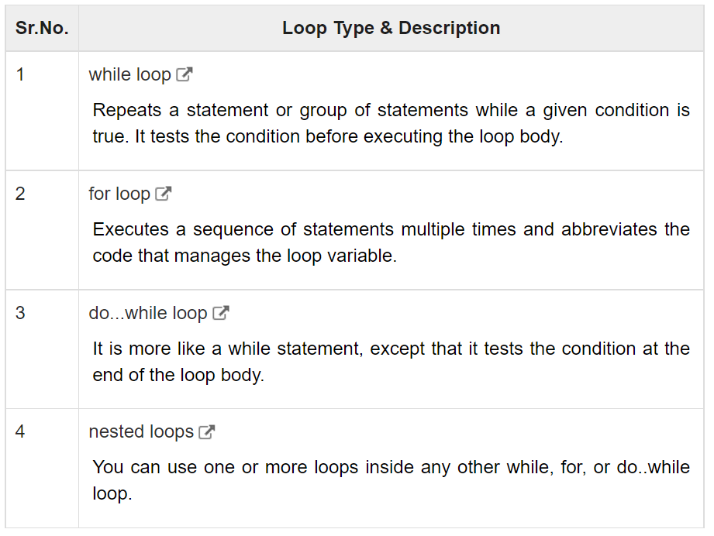
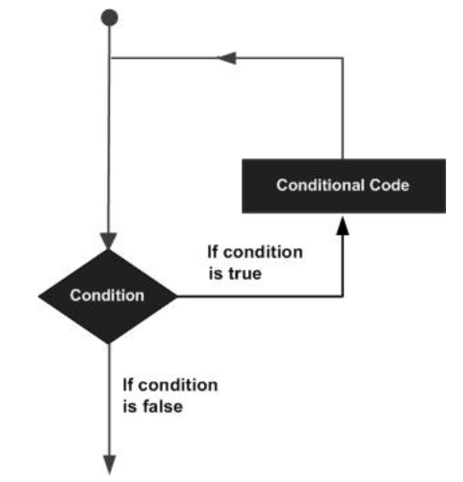
Loops
A loop statement allows us to execute a statement or group of statements multiple times.

Slide 19
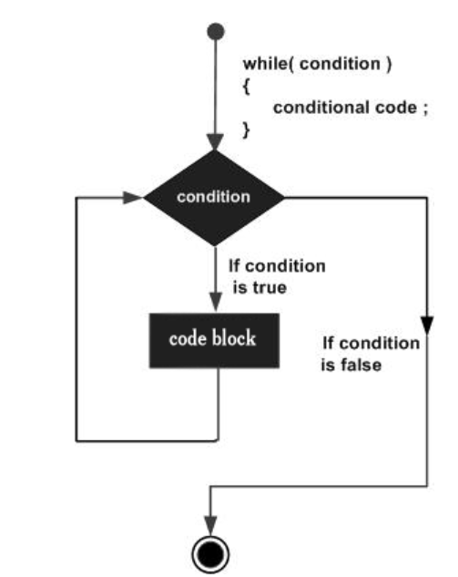
Loops While & Do While
Syntax of while loop:
while(condition) {
statement(s);
}
Syntax of do while loop:
do {
statement(s);
} while( condition );

Slide 20
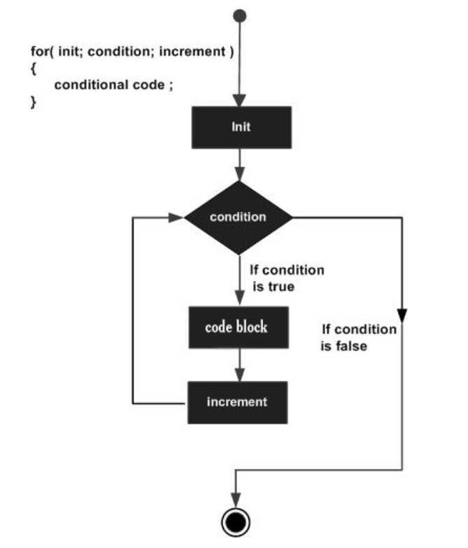
Loops for
Syntax of for loop:
for ( <init variable>; <condition>; <increment> ) {
statement(s);
}

Slide 21
Arrays
Arrays a kind of data structure that can store a fixed-size sequential collection of elements of the same type. An array is used to store a collection of data, but it is often more useful to think of an array as a collection of variables of the same type.
Instead of declaring individual variables, such as number0, number1, ..., and number99, you declare one array variable such as numbers and use numbers[0], numbers[1], and ..., numbers[99] to represent individual variables. A specific element in an array is accessed by an index.

Slide 22
Arrays
All arrays consist of contiguous memory locations. The lowest address corresponds to the first element and the highest address to the last element.

Slide 23
Arrays
Defining arrays:
<data type> <arrayName> [ <array size>];
Array size must be an integer constant greater than zero and type can be any valid C data type. For example, to declare a 10-element array called balance of type double:
double balance[10];

Slide 24
Arrays
You can initialize array elements 1 by 1 or all at once when first defined. The syntax for initializing when first declaring is:
double example[5] = {1000.0, 2.0, 3.4, 7.0, 50.0};
The number of values you initialize it with cannot be greater than the size of the array. If you leave the size field empty, the array will have the size of number of elements you initialize it with.
double example[] = {3.4, 7.0, 50.0};
So the above line would create an array of size 3.

Slide 25
Arrays
The syntax to assign a value to a single element of an array is:
double example[5] = {1000.0, 2.0, 3.4, 7.0, 880.0};
example[4] = 50.0;
Note that element numbering begins at 0, so in reality the above line is replacing the 5th value (880.0) with 50.0

Slide 26
Arrays
Lastly, in order to use array elements, you can use the following syntax:
double variable = example[0];
You would use the array name, followed directly by [<element index>]
#include <stdio.h>
int main () {
int n[ 10 ]; /* n is an array of 10 integers */
int i,j;
/* initialize elements of array n to 0 */
for ( i = 0; i < 10; i++ ) {
n[ i ] = i + 100; /* set element at location i to i + 100 */
}
/* output each array element's value */
for (j = 0; j < 10; j++ ) {
printf("Element[%d] = %d\n", j, n[j] );
}
return 0;
}

Slide 27
Functions
A function is a group of statements that together perform a task. Every C program has at least one function, which is main(), and all the most trivial programs can define additional functions.
You can divide up your code into separate functions. How you divide up your code among different functions is up to you, but logically the division is such that each function performs a specific task.
A function declaration tells the compiler about a function's name, return type, and parameters. A function definition provides the actual body of the function.

Slide 28
Functions
The syntax for defining a function is as follows:
<return_type> <function_name> ( parameter list ) {
body of the function;
}
Parameters − A parameter is like a placeholder. When a function is called, you can pass a value to the parameter. This value is referred to as the actual parameter or argument. The parameter list refers to the type, order, and number of the parameters of a function. Parameters are optional; that is, a function may contain no parameters.

Slide 29
Functions
/* function returning the max between two numbers */
int max(int num1, int num2) {
/* local variable declaration */
int result;
if (num1 > num2)
result = num1;
else
result = num2;
return result;
}

Slide 30
Functions
A function declaration tells the compiler about a function name and how to call the function. The actual body of the function can be defined separately.
A function declaration has the following parts −
<return_type> <function_name>( parameter list );
For the previously defined function max(), the function declaration is as follows:
int max(int num1, int num2);
Header files are commonly used to store function declarations.

Slide 31
Functions
In order for the main() body of your program to use your function, you must call your function. You will invoke the function and you can pass in the function arguments (if required) while also saving the return value from the function (if not void).
When a program calls a function, the program control is transferred to the called function. A called function performs a defined task and when its return statement is executed or when its function-ending closing brace is reached, it returns the program control back to the main program.

Slide 32
Functions
#include <stdio.h>
/* function declaration */
int max(int num1, int num2);
int main () {
/* local variable definition */
int a = 100;
int b = 200;
int ret;
/* calling a function to get max value */
ret = max(a, b);
printf( "Max value is : %d\n", ret );
return 0;
}

Slide 33
Header Files
A header file is a file with extension .h which contains C function declarations and macro definitions to be shared between several source files. There are two types of header files: the files that the programmer writes and the files that comes with your compiler.
You request to use a header file in your program by including it with the C preprocessing directive #include, like you have seen inclusion of stdio.h header file, which comes along with your compiler.
Including a header file is equal to copying the content of the header file into the program it is included in.

Slide 34
Header Files
A simple practice in C or C++ programs is that we keep all the constants, macros(#define), system wide global variables, and function declarations in the header files and include that header file wherever it is required.
You use the include directive with the following syntax to add a header file to your main program file:
#include <file> (for system header files)
#include "file" (for your own created header files in the same project directory)

Slide 35
Header Files
You can accidentally include the same header file twice and cause lots of errors. Use the following syntax for your header file so that the compiler knows to only actually include the contents of your header file once in your program.
#ifndef HEADER_FILE
#define HEADER_FILE
the entire header file file
#endif

Slide 36
Header Files
#ifndef HEADER_FILE
#define HEADER_FILE
int max(int num1, int num2);
int max(int, int);
more function declarations;
#endif

Slide 37
Project Structure
Abstraction – Hiding unnecessary details.
Header Files, Driver Code
Include Files

Slide 38
Design Flow
Identify and Plan
Implementation
Testing/Debugging

Slide 39
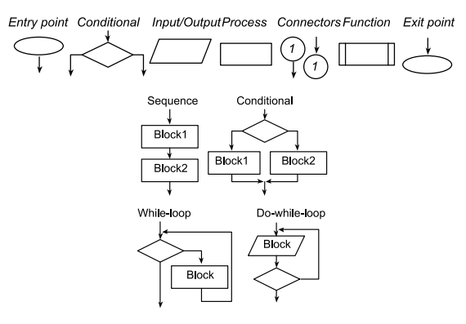
Flow Chart
Help visualize problem/code

Slide 40
Debugging
Breakpoints
Step In, Step Over, Step Out
Watch expressions
Test Cases
Print Debugging
Rubber Ducky

Slide 41
Example 1: Rock Paper Scissors
https://www.geeksforgeeks.org/rock-paper-scissor-in-c/

