Slide 1



Introduction to Programming in c

Slide 2
ToPICs List
Variables
Syntax
Data Types
Constants
Strings
Print & Scan
Comments
Operators
Logic (Decision Making)
Loops
Arrays
Functions
Project Structure
Design Flow
Debugging

Slide 3
Compilation
Compiling is the transformation from Source Code (human readable) into machine code (computer executable). A compiler is a program. A compiler takes the recipe (code) for a new program (written in a high level language) and transforms this Code into a new language (Machine Language) that can be understood by the computer itself. This "machine language" is difficult to impossible for humans to read and understand (much less debug and maintain), thus the need for "high level languages" such as C.

Slide 4
Syntax
In a C program, the semicolon is a statement terminator. So each individual statement must be ended with a semicolon. It indicates the end of one logical entity. Given below are two different statements −
    printf("Hello, World! \n");
    return 0;
A C identifier is a name used to identify a variable, function, or any other user-defined item. An identifier starts with a letter A to Z, a to z, or an underscore '_' followed by zero or more letters, underscores, and digits (0 to 9).
C does not allow punctuation characters such as @, $, and % within identifiers. C is a case-sensitive programming language.

Slide 5
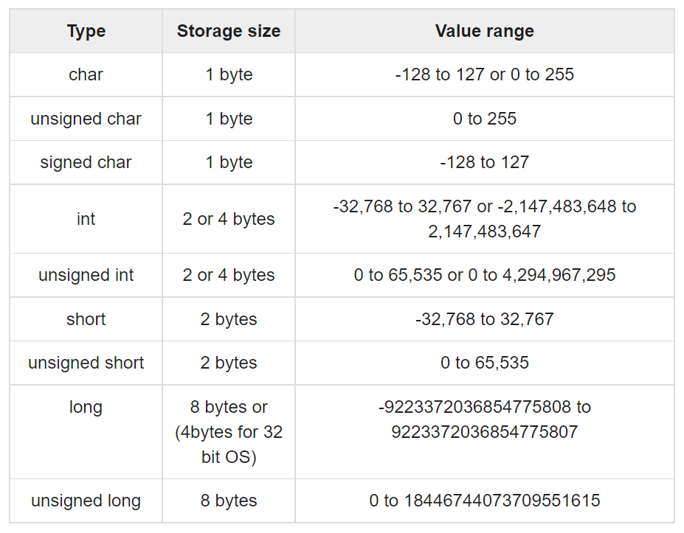
Data Types
Integer Types

Slide 6
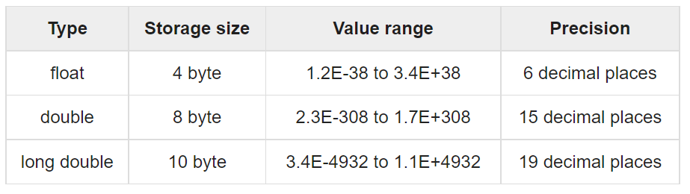
Data Types
Floating-Point Type
Void type and keyword is used to specify that no value is available. This can be used for function outputs or arguments.

Slide 7
Strings
Strings are a special type which are actually just a one-dimensional array of characters terminated by a null character ‘\0’.
The first way to create a string is by defining an array of individual characters: char greeting[6] = {'H', 'e', 'l', 'l', 'o', '\0’};
The second way is by using “” and also defining a char array:
char greeting[] = “Hello”;
In the second method, the compiler will include the null character at the end of the array automatically.

Slide 8
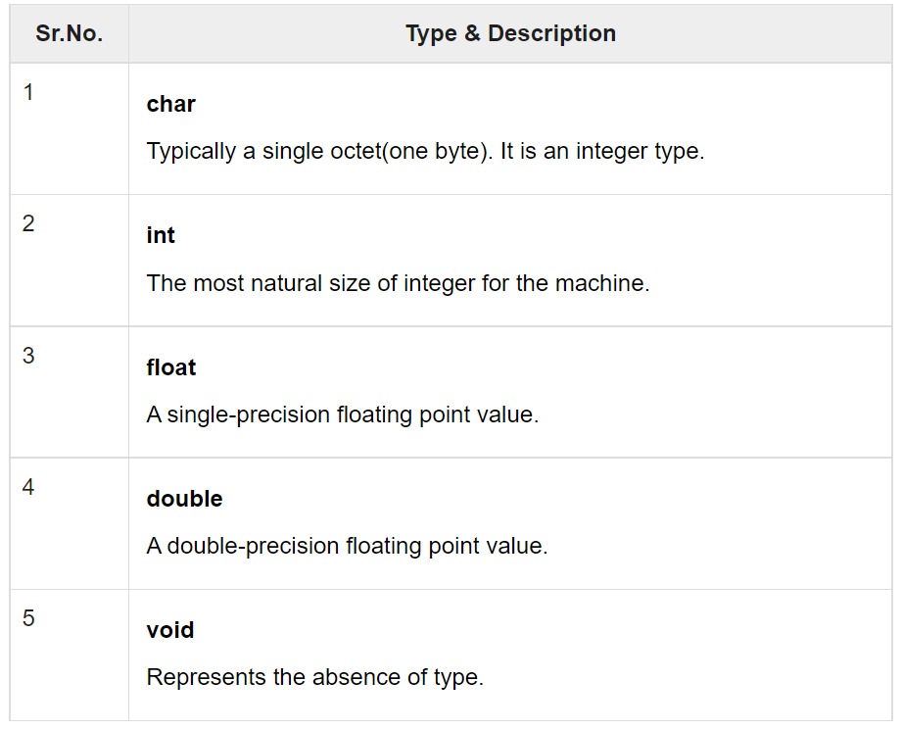
Variables
A variable is a storage area that our programs can modify. A variable always has a data-type

Slide 9
Variables
A variable is defined with the following syntax:
    <type> <variable name>;
    int x, y, z;
    char a, b, example;
    float var_f;
    double decimal8;
A variable can then be initialized in a later line, or at the same time it is defined
    int z = 99;
    example = ‘F’;

Slide 10
Constants
Constants refer to fixed values that the program may not alter during its execution. These fixed values are also called literals.
Constants can be of any of the basic data types like an integer constant, a floating constant, a character constant, or a string literal.
You can create a constant using the “define” or “const” keyword
    <#define> <identifier name> <identifier value> (no ; needed)
    <const> <data type> <variable name> = <value>;
    #define favorite 7
    #define example 28
    const char letter = ‘d’;

Slide 11
Print & Scan
I/o
Scanf is the keyword used for user input
Printf is the keyword used for program output
The int scanf(const char *format, ...) function reads the input from the standard input stream stdin and scans that input according to the format provided.
The int printf(const char *format, ...) function writes the output to the standard output stream stdout and produces the output according to the format provided.

Slide 12
Print & Scan
I/o Example
#include <stdio.h>
int main( ) {
char str[100];
int i;
printf( "Enter a value :");
scanf("%s %d", str, &i);
printf( "\nYou entered: %s %d ", str, i);
return 0;
}

Slide 13
Comments
Comments do not change the outputs or functionality of your code in anyway, they are ignored by the compiler. They are great for explaining the different parts of your code.
There are two ways to create comments in C, using // or /**/, both shown below:
    //This is a one line comment
    /*This is a
    multiple line comment*/

Slide 14
Operators
An operator is a symbol that tells the compiler to perform specific mathematical or logical functions.
There following are the different types of operators in C:
Arithmetic Operators
Relational Operators
Logical Operators
Bitwise Operators
Assignment Operators
Misc Operators
https://www.tutorialspoint.com/cprogramming/c_operators.htm

Slide 15
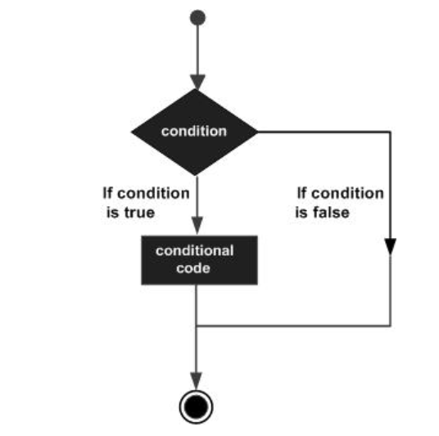
Logic (Decision Making)
Decisions in C are performed by evaluating a condition and executing a statement depending on whether the condition was met or not met.

Slide 16
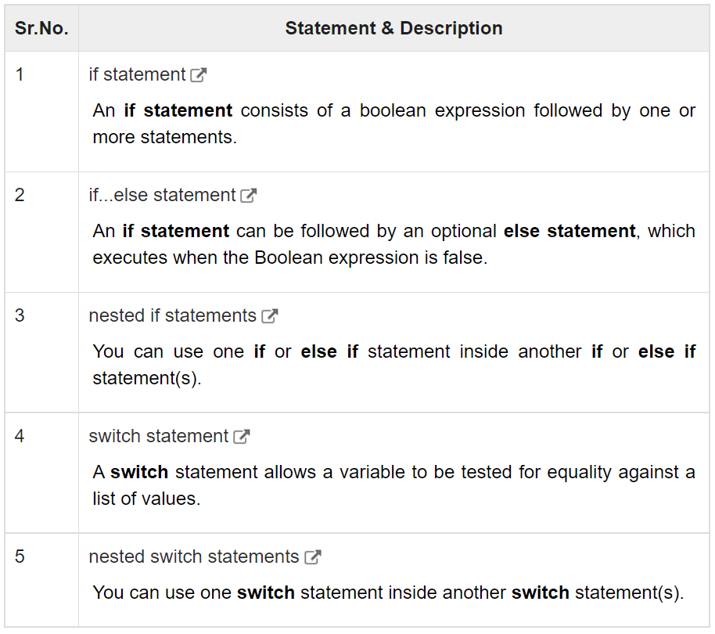
Logic (Decision Making)

Slide 17
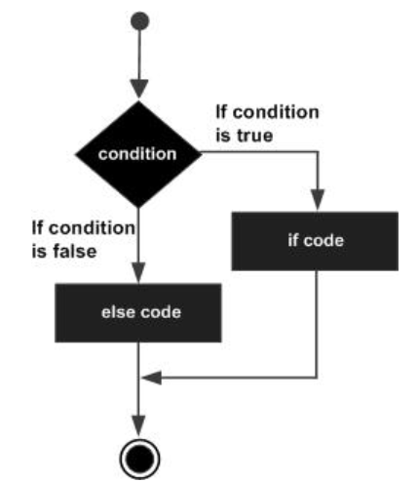
Logic (Decision Making)
The if else statement is used to evaluate a condition, and if it is not met, perform some other defined action. You can also nest if elses.
The syntax is:
if(boolean_expression) {
/* statement(s) will execute if the boolean expression is true */
} else {
/* statement(s) will execute if the boolean expression is false */
}

Slide 18
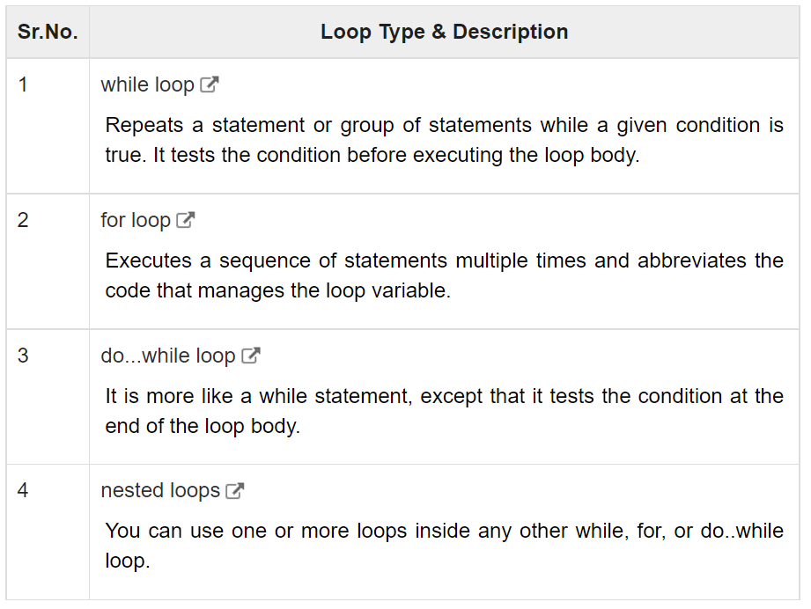
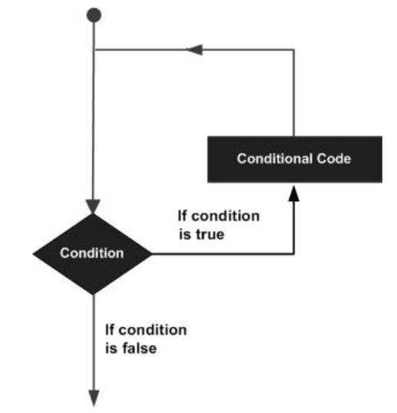
Loops
A loop statement allows us to execute a statement or group of statements multiple times.

Slide 19
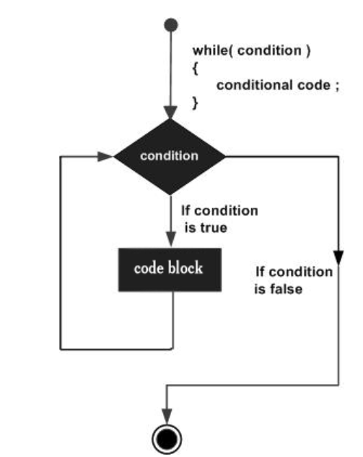
Loops
While & Do While
Syntax of while loop:
while(condition) {
statement(s);
}
Syntax of do while loop:
do {
statement(s);
} while( condition );

Slide 20
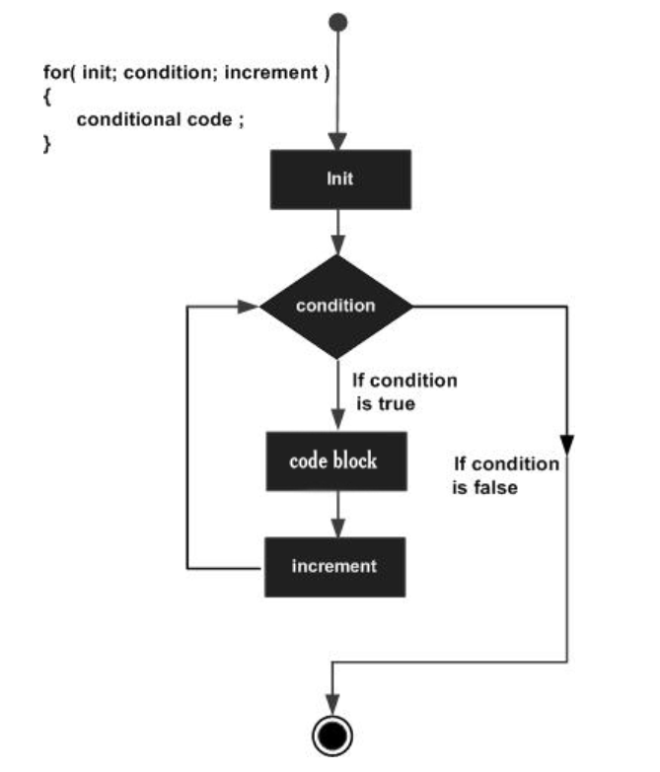
Loops for
Syntax of for loop:
for ( <init variable>; <condition>; <increment> ) {
statement(s);
}

Slide 21
Arrays (not yet)
https://youtu.be/7F-Q2oVBYKk

Slide 22
Functions (not yet)
https://youtu.be/lv5IDF7dmBk
https://youtu.be/_oyuKw3vBf8
https://youtu.be/ye2tvFir65g

Slide 23
Project Structure
Abstraction – Hiding unnecessary details.
  Header Files, Driver Code
Include Files

Slide 24
Design Flow
Identify and Plan
Implementation
Testing/Debugging

Slide 25
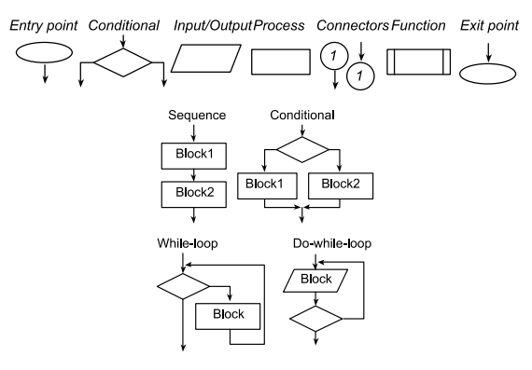
Flow Chart
Help visualize problem/code

Slide 26
Debugging
Breakpoints
Step In, Step Over, Step Out
Watch expressions
Test Cases
Print Debugging
Rubber Ducky

Slide 27
Example 1: Rock Paper Scissors
https://www.geeksforgeeks.org/rock-paper-scissor-in-c/

